Slide 1

Class of 2030
Course Selection
Notes:
It is that time of year again---Course Selection!!! Please listen carefully to the following presentation.

Slide 2
DHS Administrators
Principal—Corey Stewart
Associate Principal—Nancy Thomas
Assistant Principal—Dr. Deanna Eiland-MIller
Assistant Principal—Jorge Garza
Assistant Principal—Sarah Morvant
Assistant Principal—Dr. Trey Brasher

Slide 3
DHS Counselors
Counselor—Angela Ball
Counselor—Nicola Henry
Counselor—Chastity Rubin
Counselor—LaDale Webster
Lead Counselor—Amy Garrey
College & Career Advisor—Dr. Kasha Williams

Slide 4

What you need to graduate in 2030 with an Endorsement
4 Credits of English
4 Credits of Math
4 Credits of Science
4 Credits of Social Studies
2 Credits of World Language
½ Credit of Health
½ Credit of Professional Communications
1 Credit of PE
1 Credit of Fine Arts
5 Elective Credits
***TOTAL: 26

Slide 5
What is an Endorsement?
Selecting an ENDORSEMENT is like choosing a MAJOR in College even if you plan to go directly into the workforce. It’s your career pathway into your field of interest.
There are 5 Endorsement Areas w/ each having several specializations:
STEM
Business and Industry
Public Services
Arts and Humanities
Multidisciplinary Studies

Slide 6
Endorsement # 1
STEM
Science, Technology, Engineering, Math

Slide 7
STEM Endorsement Pathways
Engineering
Programming & Software Development
Cybersecurity
Science
Math

Slide 8
Endorsement #2
Business and Industry

Slide 9
Business and Industry Endorsement Pathways
Animal Science
Architectural & Construction
HVAC & Sheet Metal
Accounting & Financial Services
Digital Communication
Culinary Arts
Networking Systems
Welding
Automotive
Cosmetologyx
Barbering
Journalism/Yearbook
Journalism/Broadcast
English/Debate

Slide 10
Endorsement #3
Public Services

Slide 11
Public Service Endorsement Pathways
Teaching & Training
Diagnostic & Therapeutic Services
Biomedical
JROTC
Health and Wellness
Law Enforcement

Slide 12
Endorsement #4
Arts and Humanities

Slide 13
Arts & Humanities Endorsement Pathways
Drawing or Painting or Ceramics or Sculpture or Digital Art
Band
Orchestra
Color Guard
Choir
Theater or Theater Production or Technical Theater
Dance or Dance Team
Single or Multiple World Languages
Social Studies

Slide 14
Endorsement #5
Multidisciplinary

Slide 15
Multidisciplinary Endorsement Pathways
Four credits in each of the four core subjects: English, Math, Science, Social Studies (must include Chemistry or Physics)
Four credits in AP classes or Dual Credit classes
Four Advanced credit classes

Slide 16

Athletics
Cheer-tryout
Student Athletic Trainer-tryout
Cross Country
Football
Volleyball-tryout
Golf-tryout
Swimming-tryout
Water Polo-tryout
Basketball-tryout
Soccer-tryout
Baseball-tryout
Softball-tryout
Tennis-tryout
Track

Slide 17
Athletics
In order to participate, you must be in an Athletics Class.
Multiple-sport athletes will sign up for the sport that occurs first.
You must submit new physical and RankOne forms each year.
“Tryout” sports vs “Signup” sports…

Slide 18
Important!!
You must have alternates. If the classes you choose don’t make, the counselors will select your next alternate.
No alternates and your counselor will choose a class for you.

Slide 19
What happens if you don’t complete your course selection online?
Your counselor will choose all courses for you with NO option to change at a later date for ANY reason. You will be disappointed when you are taking classes that you did not choose yourself.
Notes:
Read as is

Slide 20
Level Changes
Carefully choose your classes – courses and levels
Listen to your teachers regarding level choice recommendations
Level changes do not begin until week 4 of the new school year. Students are expected to seek support from their teachers prior to a level change.
Students experiencing success (maintaining a C or better) should remain in the class for the semester.
Notes:
It is okay to take honors in one class and not another
Discuss choosing the correct level and the slim chance of getting it changed.
Classes they take for HS credit in MS—if student does not pass BOTH semesters of a course for HS credit neither semester will be in student’s course history. It is all or nothing.
Not attending DHS next year—still submit a course selection sheet!

Slide 21
What should 9th grader take next year?
English 1 (On-Level or AAC)
Algebra 1 (On-Level or AAC)
OR
if in Algebra 1 now, Geometry (On-Level or AAC)
Biology (On-Level or AAC)
World Geography On-Level or AAC or AP Human Geography

Slide 22
What should 9th grader take next year?
EXTRA Courses to think about as choices. (You need 7 classes)
Are you in a sport? Which one? You can only be enrolled in one.
If not into a specific sport team, then maybe your year of PE. Get it out of the way as a FRESHMAN.
You need one PE or PE Substitute credit for graduation.

Slide 23
What should 9th grader take next year?
EXTRA Courses to think about as choices. (You need 7 classes)
Have you completed your 2 years of foreign language?
You need a year of fine arts to graduate. (art, band, choir, theatre, dance)
Endorsement class. Are you taking the first one?

Slide 24
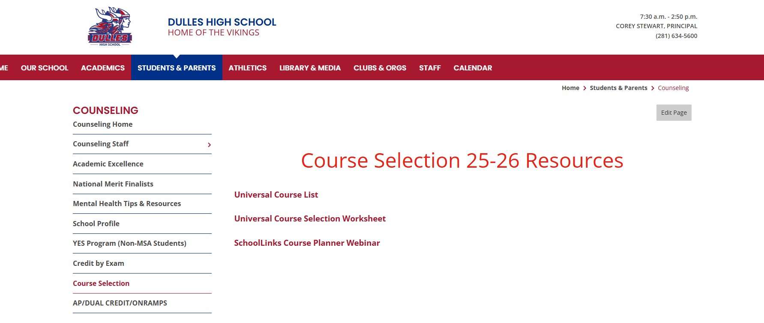
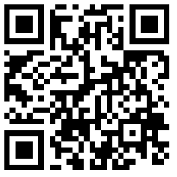
Resources for Course Selection

Slide 25

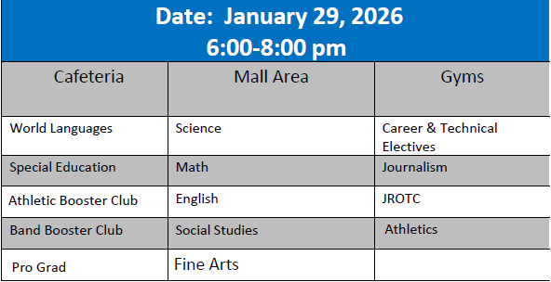
Dulles High School Course Selection Fair

Slide 26
Dulles High School Course Selection Fair
Breakout Session Descriptions:
•AP vs. Dual Credit vs. OnRamps– Learn the differences between and benefits of each.--Library
•AVID – Learn about the college and career readiness elective offered at DHS—C101
.•Graduation Requirements--What is a CCMR Point?--Come learn what a CCMR point is, how to earn one and why it is needed before graduation.—B104
•TELPAS & Emergent Bilingual--Learn about how the TELPAS test affects ESLplacement—C102

Slide 27
DHS Course Selection Passport
Students will receive a passport.
Visit tables to collect stamps/stickers from the following:
4 core classes for next year—English, Math, Science Social Studies
3 electives for next year
At the end of the evening, drop your completed passport in the 8th grade box.
Drawings will be held the following day for prizes
Make sure you include your name and email so we can contact you.

Slide 28
Online Help Desk
February 5th from 11:30 am -1:00 pm
February 12th from 11:30 am – 1:00 pm
Help Desk will be via Teams. A link will be sent out to you via email. You can also find it on our website.

Slide 29
Thank you!

